Slide 1
The Club of Cheerful and Witted Students

Slide 2
write down the words in the alphabetical order.
holiday 2) present 3) send 4) apple
5) chocolate 6) flower 7) work 8) bed 9) table
10) Last 11) kiss 12) you 13) orange 14) dear 15) name 16) end 17) garden 18) ice 19) jam 20) mother 21) queen 22) union 23) right
24) zoo 25) vase 26) xylophone

Slide 3
write down the words in the alphabetical order.
apple,2) bed, 3) chocolate, 4) dear, 5) end,
6) flower,7) garden, 8) holiday, 9) ice,10) jam, 11) kiss,12) last,13) mother, 14) name,
15) orange, 16) present, 17) queen,18) right, 19) send, 20) table, 21) union, 22) vase,
23) work, 24) xylophone, 25) you, 26) zoo.

Slide 4
“5 Themes” – name 10 words on the following themes:
“Family”, “Food”, “Sport”, “School”, “Months”,
“Holidays”.

Slide 5
“Odd Word” – find one odd word in each line.
1) blue, black, pink, yellow, melon
2) speak, answer, sing, breakfast, translate
3) potato, tomato, carrot, pear, tree
4) tiger, lion, bird, elephant, rabbit
5) summer, winter, rain, spring, autumn
6) carpet, sausage, apple, juice, cheese
7) teacher, pupil, blackboard, manager, book
8) mother, sister, aunt, dad, doctor
9) decoration, bananas, celebration, toys, lights

Slide 6
“Odd Word” – find one odd word in each line.
1) blue, black, pink, yellow, melon
2) speak, answer, sing, breakfast, translate
3) potato, tomato, carrot, pear, tree
4) tiger, lion, bird, elephant, rabbit
5) summer, winter, rain, spring, autumn
6) carpet, sausage, apple, juice, cheese
7) teacher, pupil, blackboard, manager, book
8) mother, sister, aunt, dad, doctor
9) decoration, bananas, celebration, toys, lights

Slide 7
“Mistakes” – find a spelling mistake in one word of each sentence.
1) I have brekfast at eight.
2) Her mather and father are teachers.
3) I like to drink koffee.

Slide 8
“Mistakes” – find a spelling mistake in one word of each sentence.
1) I have breakfast at eight.
2) Her mother and father are teachers.
3) I like to drink coffee.

Slide 9
Guess the words from the following letters:
wnrob, yphap, tisers, erfath, tewaehr, motahobr.

Slide 10
Guess the words from the following letters:
brown, happy, sister, father, weather, bathroom.

Slide 11
Find the opposites.
1) warm man
2) take sit
3) remember small
4) hello day
5) white black
6) night good-bye
7) cat give
8) stand dog
9) big cool
10) woman forget

Slide 12
Find the opposites.
1) warm cool
2) take give
3) remember forget
4) hello good-bye
5) white black
6) night day
7) cat dog
8) stand sit
9) big small
10) woman man

Slide 13
Make up as many words as you can.
A T W G O K E C U B N I V P

Slide 14
Make up as many words as you can.
At, cup, cake, cube, but, we, note, vip, nut, new, back, tea, on, no, tick, bat, net, big, two, pen, not, kite, bike, cat, wave,poet,pan,pin,

Slide 15
“Mistakes” – find a grammar mistake in each sentence.
There is many snow in the park.
She want to read a book.
Did we have written a dictation today?
Has they went to school today?
Her hair are black.
There are a few sugar in the cup.
These are mine books.
Where are the money? They are on the table.
She not drew a picture.

Slide 16
“Mistakes” – find a grammar mistake in each sentence.
There is much snow in the park.
She wants to read a book.
Have we written a dictation today?
Have they gone to school today?
Her hair is black.
There is a little sugar in the cup.
These are my books.
Where is the money? It is on the table.
She didn’t draw a picture.

Slide 17
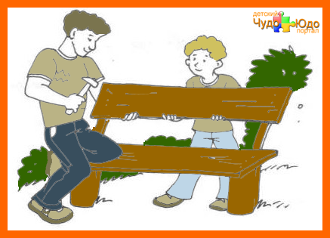
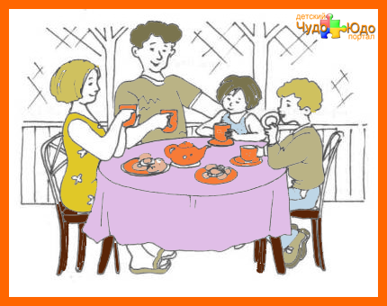
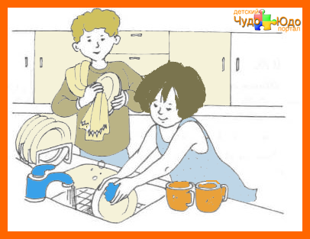
Make up a story

Slide 18
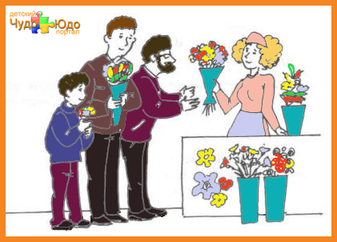
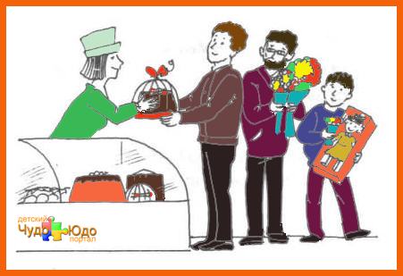
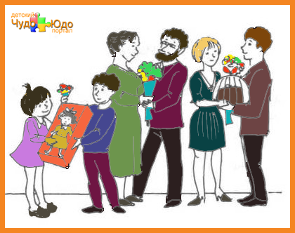
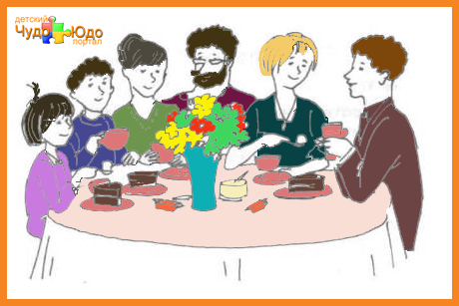
Make up a story

